Slide 1

Course Name - Object Oriented Programming using Java
Lecture 3– Object Oriented Programming concepts - Difference between OOP and other conventional programming – advantages and disadvantages. Class, object, Method.
Presented By
Dr. Sudipta Sahana
Associate Professor
Dept. of CSE
UEM - Kolkata

Slide 2
Topic of Interest
Object-oriented programming: concept
Difference between Conventional Programming and Object Oriented Programming
Advantages of OOP
Disadvantages of OOP
Object
Class
Method

Slide 3
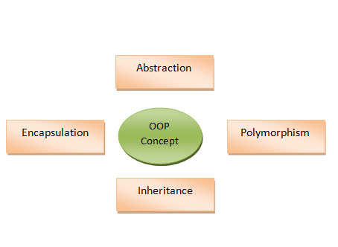
Object Oriented Programming:
Object-Oriented Programming or OOPs refers to languages that uses objects in programming. Object-oriented programming aims to implement real-world entities like inheritance, hiding, polymorphism etc in programming. The main aim of OOP is to bind together the data and the methods that operate on them so that no other part of the code can access this data except that method.

Slide 4
Difference between Conventional Programming and Object Oriented Programming:
CONVENTIONAL PROGRAMMING | OBJECT ORIENTED PROGRAMMING
In conventional programming, program is divided into small parts called functions. | In object oriented programming, program is divided into small parts called objects.
Conventional programming follows top down approach. | Object oriented programming follows bottom up approach.
There is no access specifier in conventional programming. | Object oriented programming have access specifiers like private, public, protected etc.
Adding new data and function is not easy. | Adding new data and function is easy.
Conventional programming does not have any proper way for hiding data so it is less secure. | Object oriented programming provides data hiding so it is more secure.
In conventional programming, overloading is not possible. | Overloading is possible in object oriented programming.
Examples: C, FORTRAN, Pascal, Basic etc. | Examples: C++, Java, Python, C# etc.
.

Slide 5
Advantages of OOP
Due to the various problems faced by the procedural languages, this concept was introduced. Therefore, it has a number of advantages over the procedural programming. OOP is still being widely used; new languages also adopt these OOP concepts. Let us discuss some the advantages of the Object-oriented programming:
Real Word Entities
Code Reusability
Easy Management
Maintenance
Abstraction
Polymorphism

Slide 6
Disadvantages of OOP
Despite of having so many advantages it also has disadvantages.
Proper planning and designing is required in OOP
OOP programs design are tricky
Large size & Many Instructions
Classes tends to be over generalised

Slide 7
Class in OOP
A class is a group of objects which have common properties. It is a template or blueprint from which objects are created. It is a logical entity. It can't be physical. A class in Java can contain:A class represents a collection of objects having same characteristic properties that exhibit common behavior.
It gives the blueprint or description of the objects that can be created from it. Creation of an object as a member of a class is called instantiation. Thus, object is an instance of a class

Slide 8
How to Create a Class
To create a class, use the keyword class
Create a class named "MyClass" with a variable x:
public class MyClass {
int x = 5;
}

Slide 9
Object
An object is a real-world element in an object–oriented environment that may have a physical or a conceptual existence.
Objects can be modelled according to the needs of the application. An object may have a physical existence, like a customer, a car, etc.; or an intangible conceptual existence, like a project, a process, etc.

Slide 10
How to create an Object
In Java, an object is created from a class. We have already created the class named MyClass, so now we can use this to create objects.
To create an object of MyClass, specify the class name, followed by the object name, and use the keyword new:
Example
Create an object called "myObj" and print the value of x:
public class MyClass {
int x = 5;
public static void main(String[] args) { MyClass myObj = new MyClass(); System.out.println(myObj.x);
}
}

Slide 11
Method
A method is a collection of statements that perform some specific task and return result to the caller. A method can perform some specific task without returning anything. Methods allow us to reuse the code without retyping the code. In Java, every method must be part of some class which is different from languages like C, C++ and Python.
Methods are time savers and help us to reuse the code without retyping the code.

Slide 12
Thank You

